Slide 1

Final Capstone
Natural Language Processing (NLP) Recommender System for Travel Destinations
Matthew Kehoe, February 2024

Slide 2
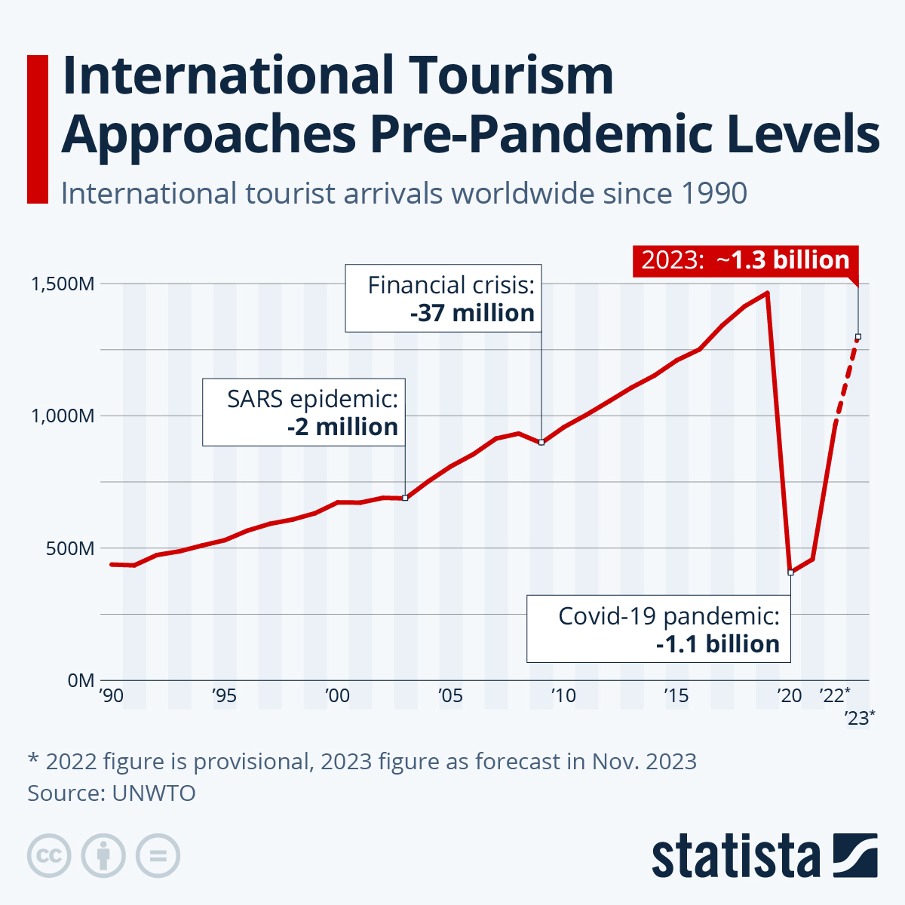
Introduction
The travel industry was heavily disrupted by the
COVID-19 pandemic.
With the development of vaccines, a lot of people
started to travel again.
In 2023, travel and tourism rebounded back to 2019
levels.
I want to create a travel app that sparks interest and
enthusiasm for exploring new destinations
Source: United Nations World Tourism Organization

Slide 3
Project Aim and Detail
There are five parts of the project:
Scrape activities from 30 travel destinations in Trip Advisor.
Perform data analysis and modeling.
Make an NLP recommender system to predict future travel destinations.
Create a Dash app to make personalized travel recommendations.
Discuss future research and enhancements.

Slide 4
Part 1 – Web Scraping

Slide 5
Data Gathered
• Used Beautiful Soup to scrape 56,109 activities from 30 destinations in Trip Advisor.
• 53,164 of the 56,109 activities are unique.
• I scraped up to 3,000 activities at the 30 travel destinations.

Slide 6
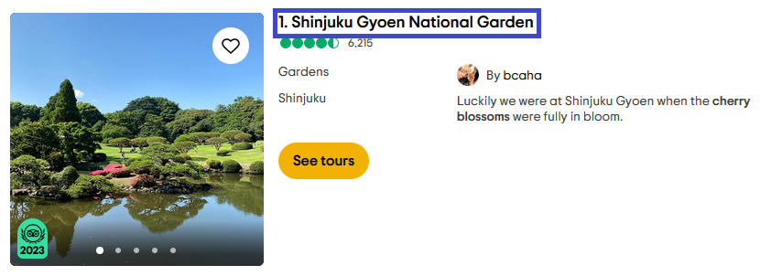
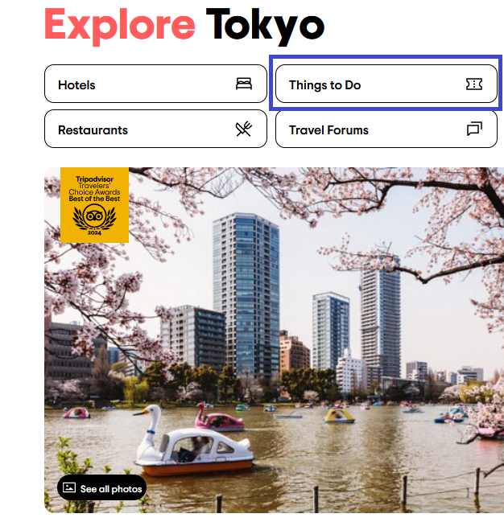
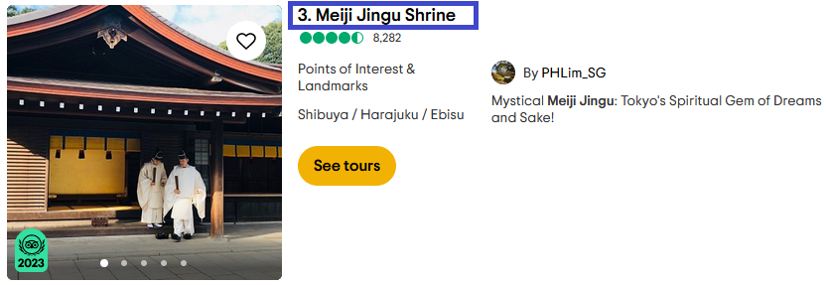
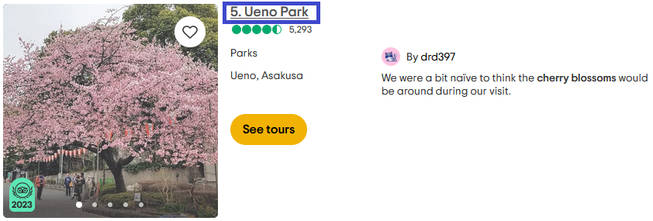
Tokyo, Japan

Slide 7
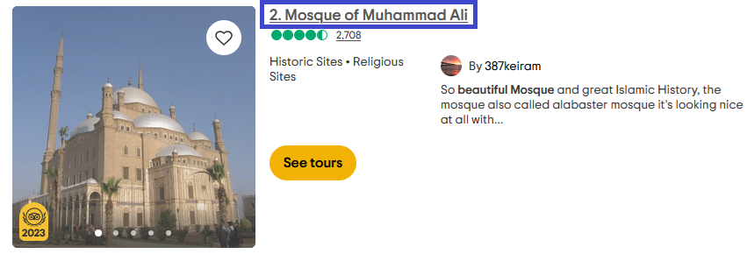
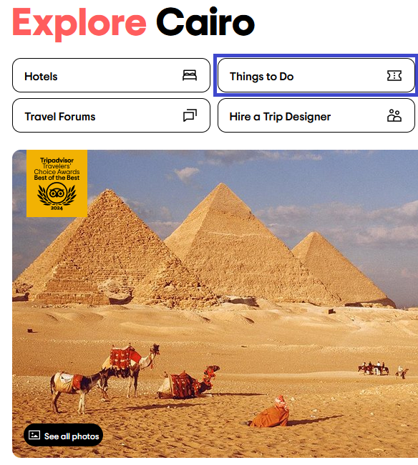
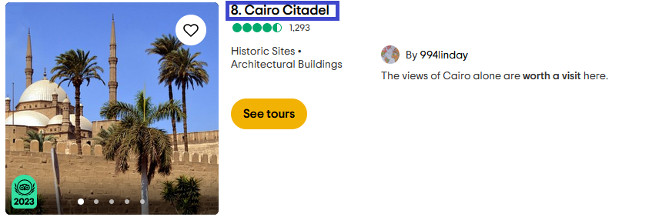
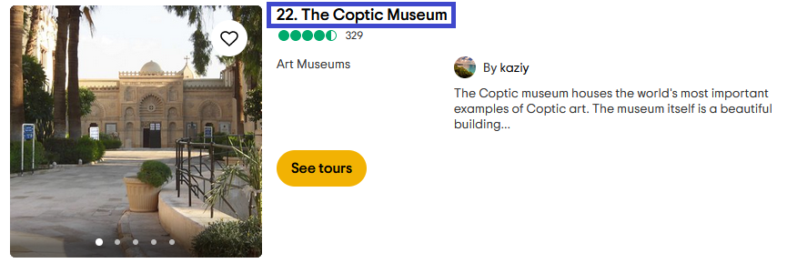
Cairo, Egypt

Slide 8
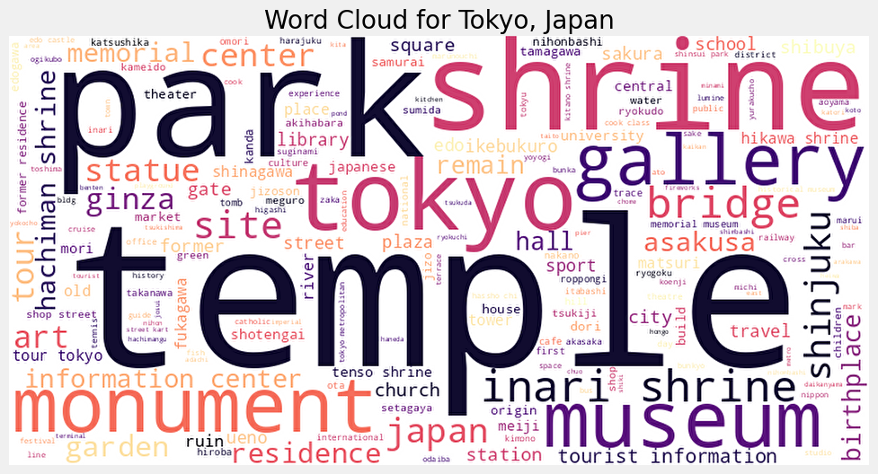
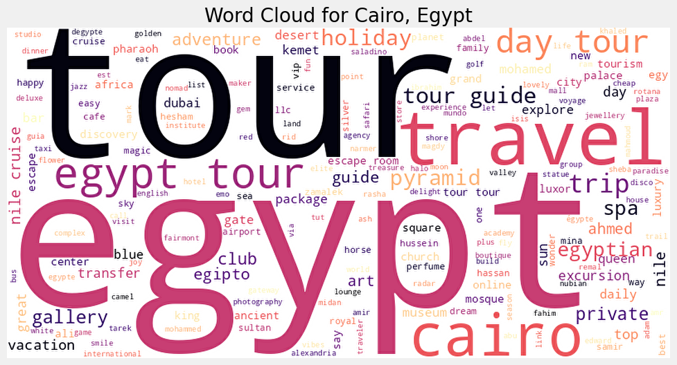
Word Clouds

Slide 9
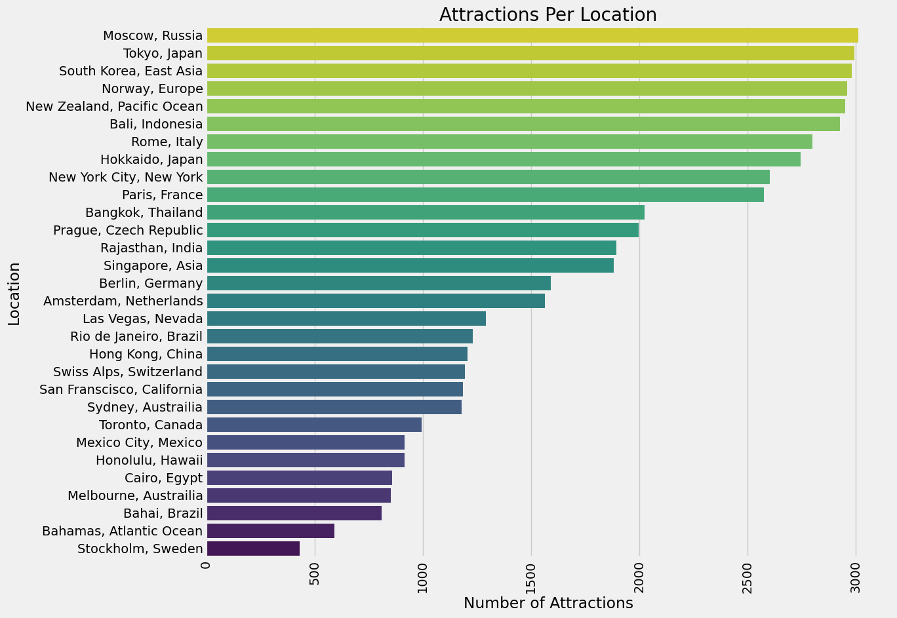
Attractions

Slide 10
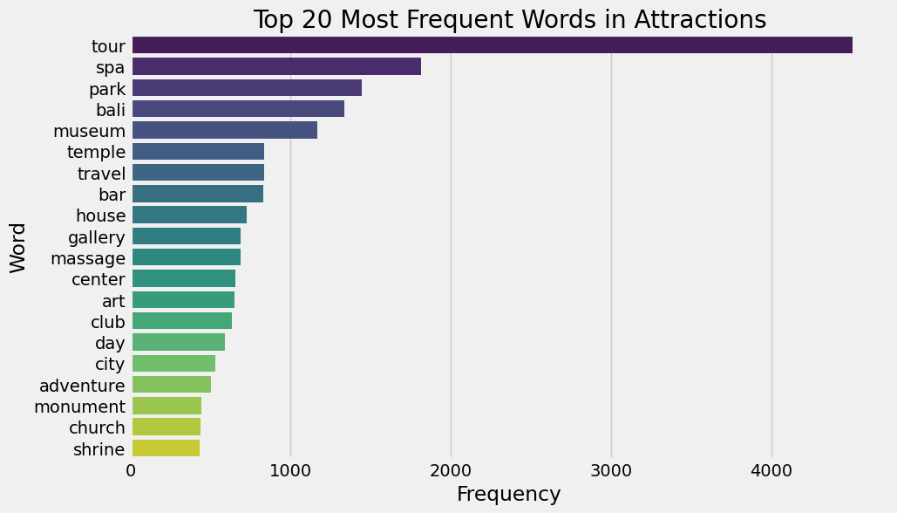
Most Frequent Words

Slide 11
Part 2 – Data Analysis and Modeling

Slide 12
Data Cleaning
Used Natural Language Toolkit (NLTK) for tokenization
Removed stop words to focus on the more meaningful and informative words in text
Lemmatization (reduced infected words to their root word)
Removed capitalization
Removed punctuation

Slide 13
Model Setup: Features and Target
• Feature Variables: Attraction text scraped from Trip Advisor (53,164 values)
• Target Variables: 30 unique locations
• This is a multiclass classification problem as the target variable has three or more classes

Slide 14
Model Setup: Train and Test
• I performed a 75/25 split on the 53,164 values corresponding to attraction text
• Train had 39,873 values
• Test had 13,291 values

Slide 15
Establishing a Baseline
• As an initial test, I used the Naïve Bayes estimator as a baseline for text classification.
• This gave me a training accuracy of 77.9% and a test accuracy of 48.0%.
• Concerned that my model was overfitting, I switched to the Complement Bayes Estimator and implemented:
TD-IDF Vectorization
Count Vectorization
Unigrams and Bigrams

Slide 16
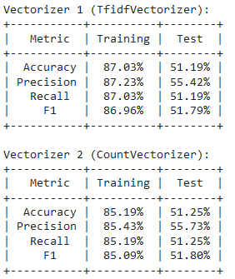
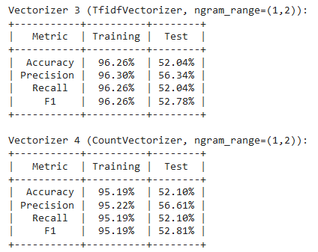
Model Comparison

Slide 17
Model Selection
I then examined classical machine learning techniques. Given that I am estimating the likelihood of more than two target variables, I will use classification methods.
K-Nearest Neighbors is my first choice.
This is a classification problem, so I will also try Logistic Regression.
Support Vector Machine is also a good choice.
I will also implement a Decision Tree classifier.
I will also try a variety of ensemble methods: Bagging Decision Tree, Boosting Decision Tree, Random Forest and Voting Classifier.

Slide 18
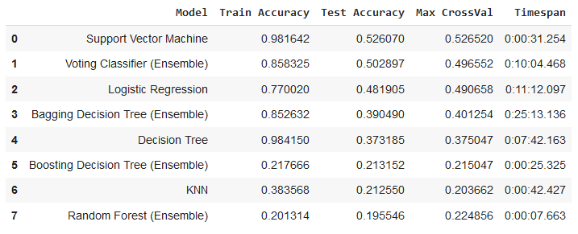
Model Results

Slide 19
Model Performance
Best performers, ranked:
Support vector Machine
Voting Classifier (Ensemble)
Logistic Regression
Bagging Decision Tree (Ensemble)
Decision Tree
Boosting Decision Tree (Ensemble)
KNN
Random Forest (Ensemble)

Slide 20
Model Speed
Fastest performers, ranked:
Random Forest (Ensemble)
Boosting Decision Tree (Ensemble)
Support Vector Machine
KNN
Decision Tree
Voting Classifier (Ensemble)
Logistic Regression
Bagging Decision Tree (Ensemble)

Slide 21
Part 3 – NLP Recommender System

Slide 22
Preliminary Recommender Systems
Cosine similarity provides a metric of how similar two objects are.
In my problem, I would like to know how similar attraction text is to user provided text for travel destinations.
I created two recommender systems using cosine similarity with TD-IDF Vectorization and Count Vectorization.
I choose “I want to eat a lot of chocolate and pizza.” as my input text.
• As before, TD-IDF Vectorization had slightly better metrics that Count Vectorization.

Slide 23
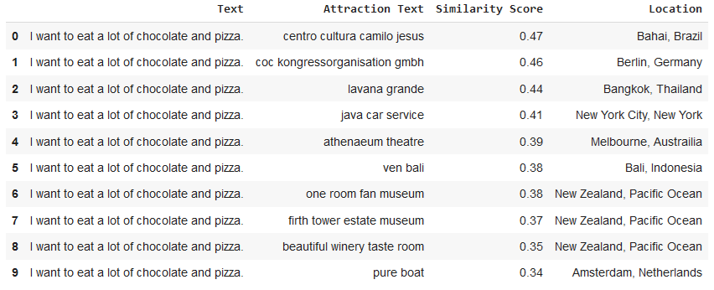
TD-IDF Vectorization Results

Slide 24
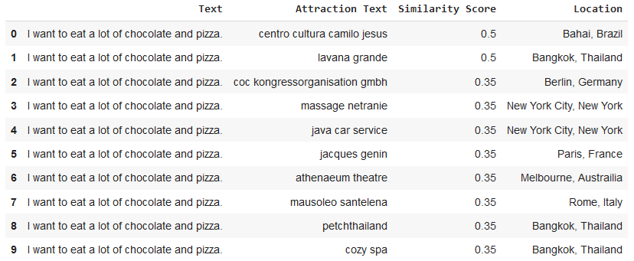
Count Vectorization Results

Slide 25
BERT
Unsatisfied with my preliminary NLP recommender systems, I investigated using a Large Language Model.
A good candidate was BERT (Bidirectional Encoder Representations from Transformers).
I used pretrained BERT embeddings from Tensorflow Hub to create word embeddings.
Specifically, my implementation was a scaled-down version of bert_un_cased which has small pretrained embeddings.
With BERT, the similarity score was significantly higher and the top ten records were all above 93%.

Slide 26
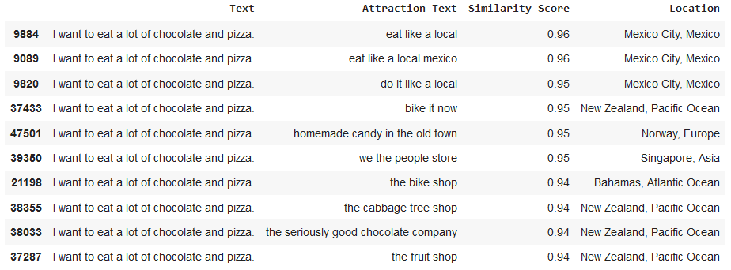
BERT Results

Slide 27
Part 4 – Dash App

Slide 28
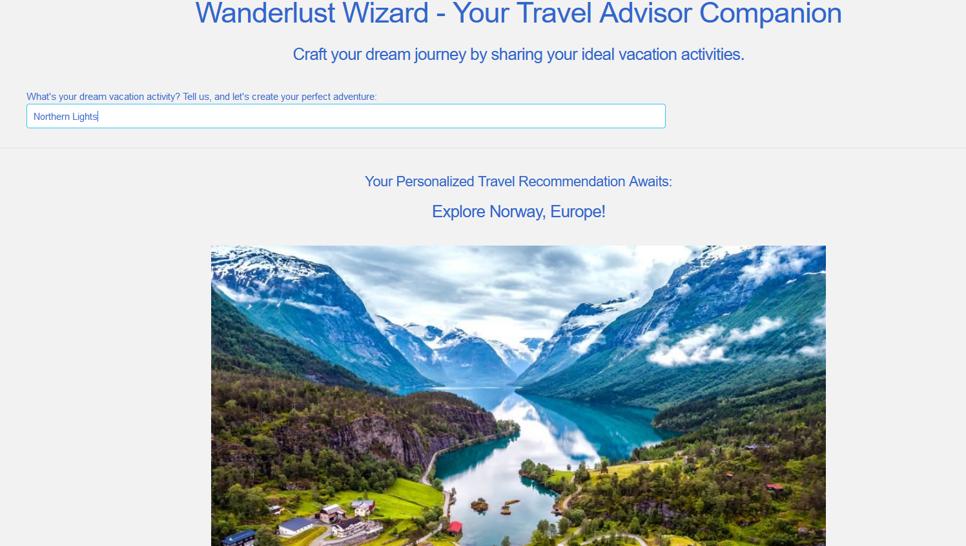
Dash App
Dash App

Slide 29
Part 5 – Conclusion and Recommendations

Slide 30
Conclusion
• Applying TD-IDF Vectorization with the Complement Bayes Estimator and Unigrams and Bigrams had the best performance metrics. This model had 96.26% accuracy in Train and 52.04% accuracy in Test.
• The 44% difference between Train and Test suggests that the distribution of data in the Test set might be different from what is in Train. I suspect that the 53,164 attraction values have repeated text that harms generalizing models to new data.
• BERT performs significantly better than TD-IDF Vectorization and Count Vectorization and achieves similarity scores above 93%.
• An interactive Dash app provides greater flexibility and vibrancy for NLP Recommender Systems.

Slide 31
Real World Applications
• The NLP Recommender System could be combined with existing travel apps (Trip Advisor, Expedia, Kayak, etc.) to give personal travel recommendations based on a few key words.
• The NLP Recommender System could also be integrated into chat bots (such as GPT-4 or Gemini) to give users personalized recommendations. The same sort of analysis would apply to any NLP Recommender System using key words to provide recommendations.
• Public travel authorities could purchase and promote their own versions of NLP Recommender Systems for their specific travel destinations.
• Instead of searching for information on Google or Trip Advisor, users could go to a website or app with a wide range of NLP Recommender Systems and find personalized recommendations.

Slide 32
Recommendations for Future Research
• Explore other LLMs: I used Tensflow Hub (which hosts a variety of pretrained models). One could also explore transfer learning in models such as GPT-3 and RoBERTa for potential advantages in their use case.
• Apply Deep Neural Networks: Further testing could be performed against a dense neural network or convnet with several dropout layers to prevent overfitting.
• Explore collaborative filtering and matrix factorization as alternative techniques for recommender systems.
• Gather travel data for more locations in Trip Advisor or locations outside of Trip Advisor.
• Further investigate the cause of the performance drop between Train and Test.

Slide 33
Questions/Discussion
• What other techniques could be used to measure discrepancies between Train and Test?
• Could common words between attractions or non-English text be causing a significant performance loss in Test?

